Slide 1

Reddit Posts Analysis with Natural Language Processing
By Daniel Seto, Florian Combelles, Goh Yan Da, Joanne Chong, Kenneth Goh
Notes:
Good Morning, we are group 2 consisting of Daniel, Florian, Joanne, Kenneth and myself, Yanda. We will be using web apis and NLP to create a classifier model to classify reddit posts.

Slide 2
Table of Contents
Executive Summary
Problem Statement
Methodology
Data Collection
Exploratory Data Analysis
Classification Models
Conclusion & Recommendations
Notes:
Here are the table of contents that will be covered today.

Slide 3
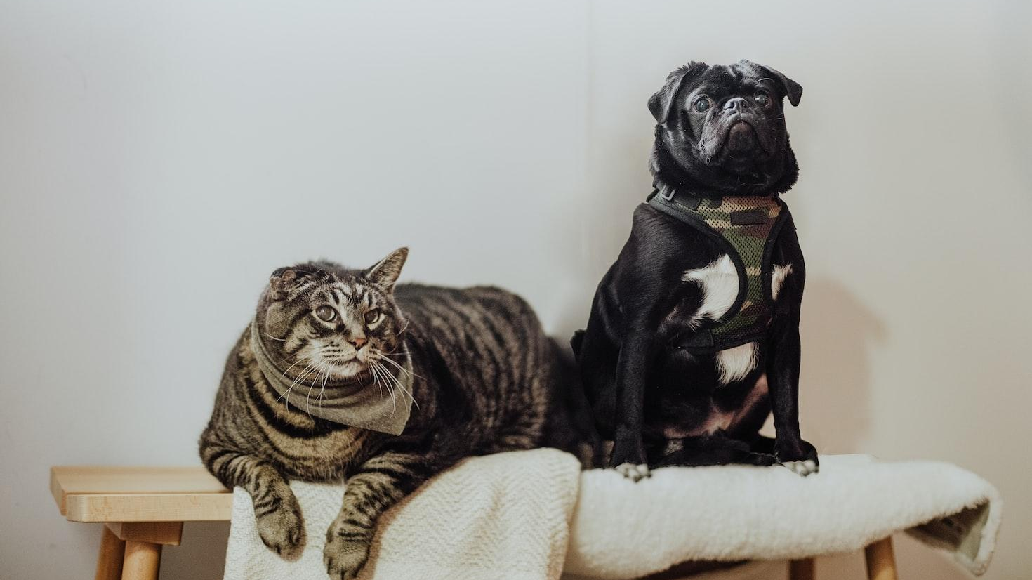
1
Executive Summary

Slide 4

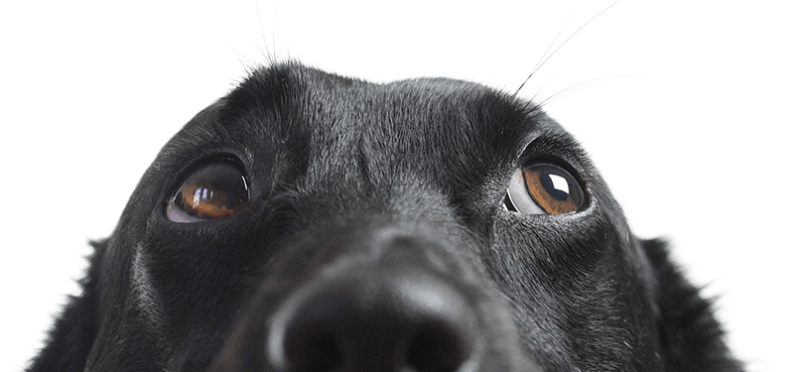
Who we are
Our mission:
“We care for them”
Smart Pet, established in August 2020 by Florian Combelles
Passion for animals with expertise from former vets, pet store owners and animal shelter volunteers
Worked with organisations and companies such as:
SPCA
AVA
Petslovers
Notes:
So, to give you guys some context, our company is called Smart Pet. It was established in August 2020 by our founder Florian Combelles. He found that the animals in Singapore were not being properly taken care of, especially with the rise of animal abuse videos surfacing on the internet. Under his guidance, he lead a team of former vets, pet store owners and animal shelter volunteers to create Smart Pet, with a goal, to improve animal welfare for pets in Singapore via the usage of technology. We have also previously worked with organisations such as SPCA, AVA and petslovers in our efforts to bring our mission forward. We are the internal data analytic department of Smart Pet tasked to form data driven decision

Slide 5
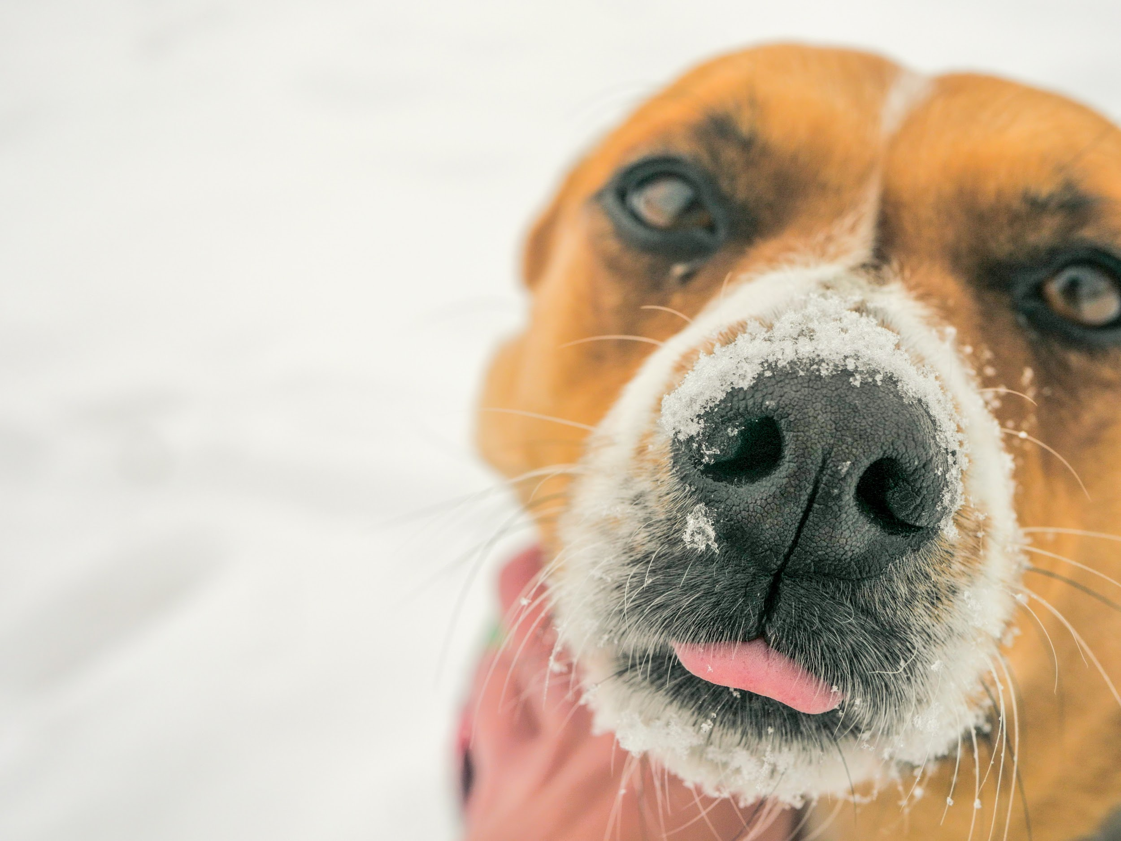
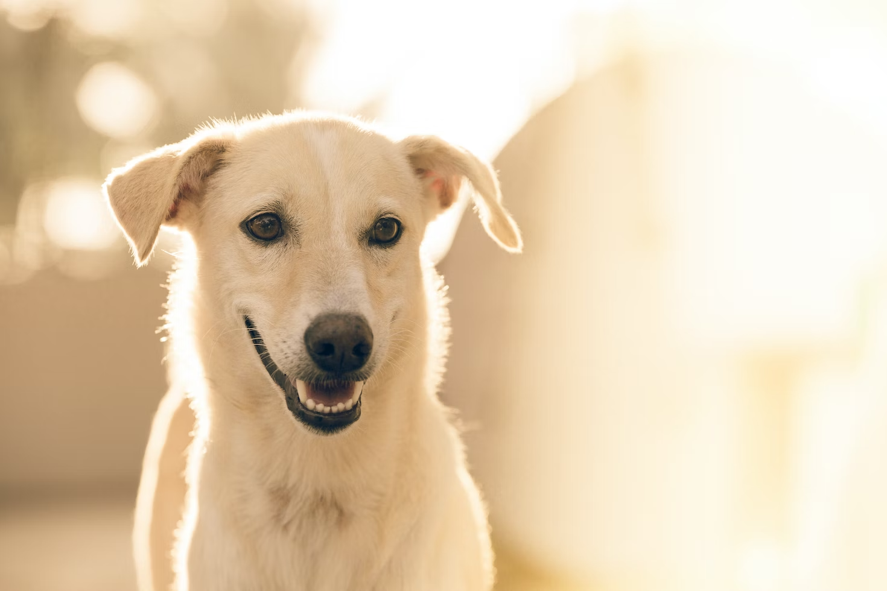
2
Problem Statement
The challenge at hand

Slide 6

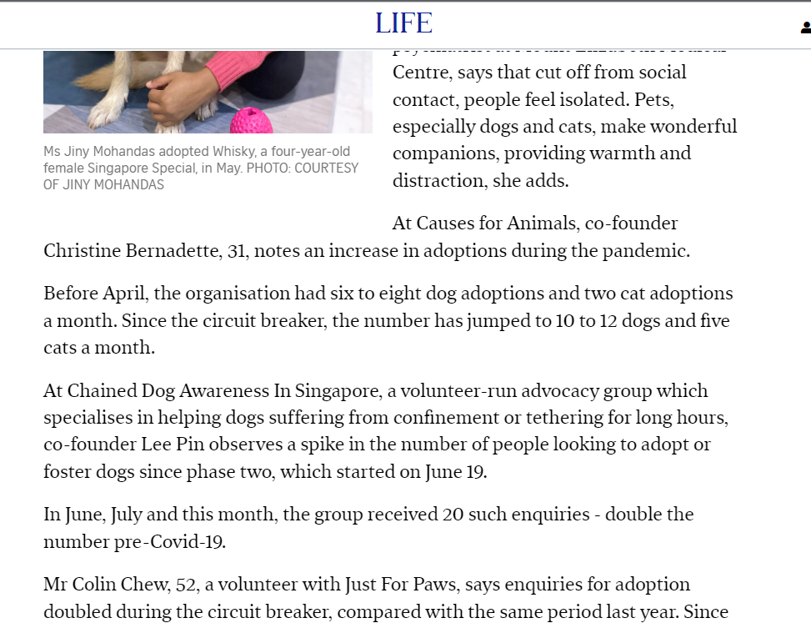
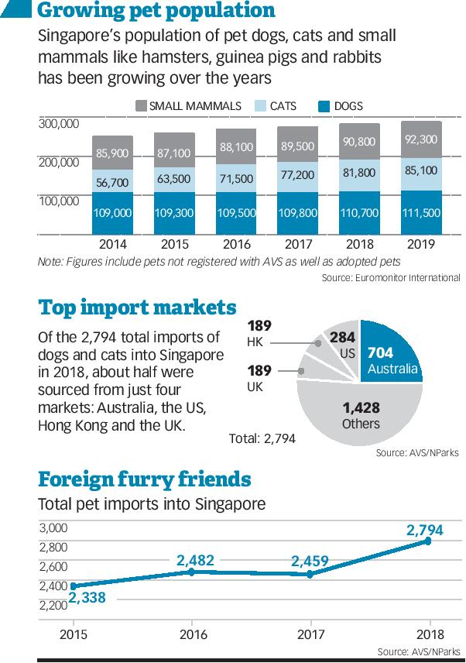
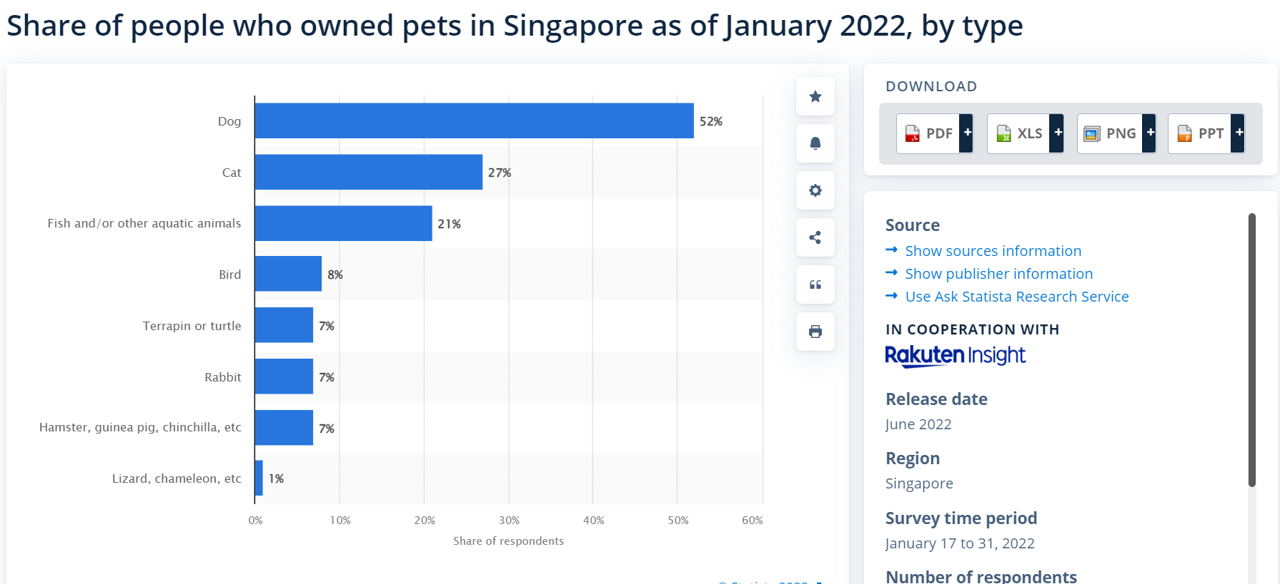
Background
Most common pets in Singapore
Dogs - 52%
Cats - 27%
Increased interest in pet ownership → Rise of inexperienced pet owners
Notes:
As we are steadily easing into a COVID-19 adjusted future, we must remember how it has affected us during the initial outbreak. Circuit breakers in Singapore meant no meet ups and thus lesser social interactions. As such, many Singaporeans turn to the companionship of pets to cope with the change. According to statisa, we can observe that majority of commonly acquired animals are dogs and cats. Dogs dominate the majority of households at 57% while coming second is cats at a 27%. Regardless of Covid, we can also see that pet ownership has been steadily increasing in Singapore as reference with the number of foreign animal import in Singapore. However, with the rise of pet ownership meant more first time fur parents which are commonly inexperienced pet owners.

Slide 7
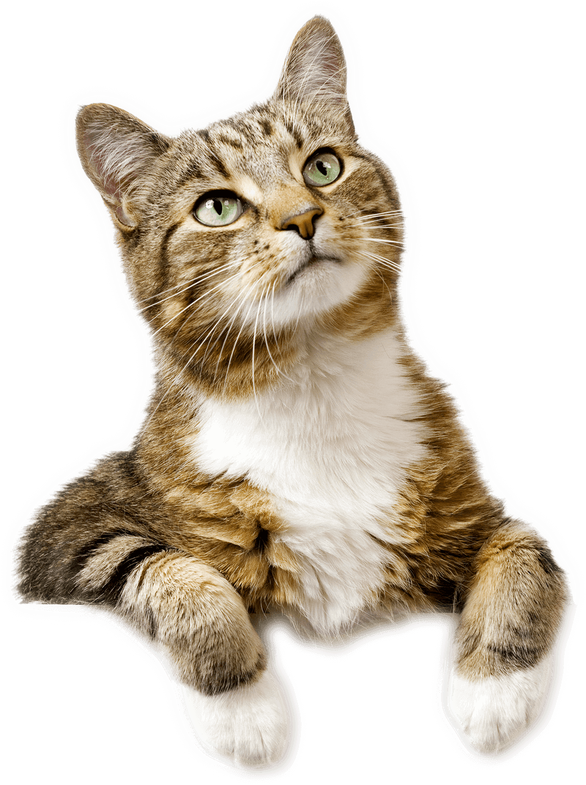
With an influx of inexperienced pets owners overly reliant on vets and pet store, how can we better optimize everyone’s time?
Notes:
So, that leads us to our problem statement. With an influx of inexperienced pet owners that are overly reliant on our stakeholders, it reduces work efficiency. How can we optimize that?

Slide 8
Stakeholders’ Concerns
Lack of local resources regarding information on:
Licensing, upkeep costs, aftercare
How does it affect you?
Decrease in work efficiency
Pet store owners occupied answering queries
Overbooking of Vet appointments
Pet owners coming in for minor enquiries/non-emergencies
More animals abandoned
Animals abandoned after pandemic are sent to the shelters
Notes:
So, how does that affect you, our stakeholders? With the rise of new fur parents, there is a lack of commonly accessible resources available for them. Local resources such as licensing, regulations, upkeep fees and after care for animals are vital in ensuring proper animal welfare. This slowly seeps into the livelihoods of our vets, pet store owners and volunteers. The repercussions of poor animal care might lead to decrease in work efficiency by pet store owners that allocate more time to answering queries by large volume of pet owners instead of targeting sales. Over booking of vet appointments as paranoid pet owners might come in for non-emergencies or negligent pet owners that arrive too late when the animal is in critical condition due to the lack of an earlier diagnosis. Lastly, with COVID easing down and people heading out, less pet owners are able to commit to owning a pet and will abandon them at animal shelters.

Slide 9
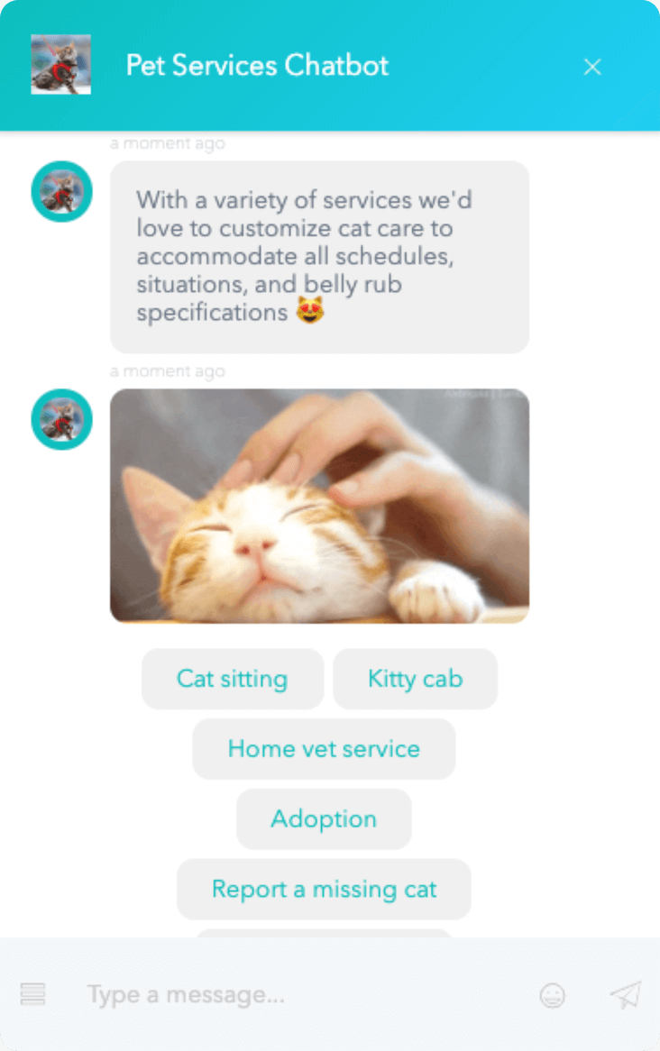
Our mobile app (beta)
Pet Companions, mobile application (currently in beta) that can offer pet owners information through:
AI-powered chatbot
First level of customer inquiry
Source of information for pet owners
Recommends articles based on classification of queries
A knowledge-bank filled with information sourced from vets, pet experts and users
Notes:
We are here to present our final flagship product, Pet Companions and how it will help you, our stakeholder. We have a mobile app currently in beta that aims to offers pet owners information via the use of our AI-powered Chatbot that uses NLP processing. Our chatbot acts as a first line of customer inquiry and source of information for pet owners. It recommends articles based on classification of user generated queries. This provides a knowledge bank filed with details and information sourced from our fellow workmen. So to generate this Chatbot, we will be developing a classifier model that correctly identifies whether a query is cat or dog related. Now I will give my time to Kenneth who will speak more on the methodology.

Slide 10
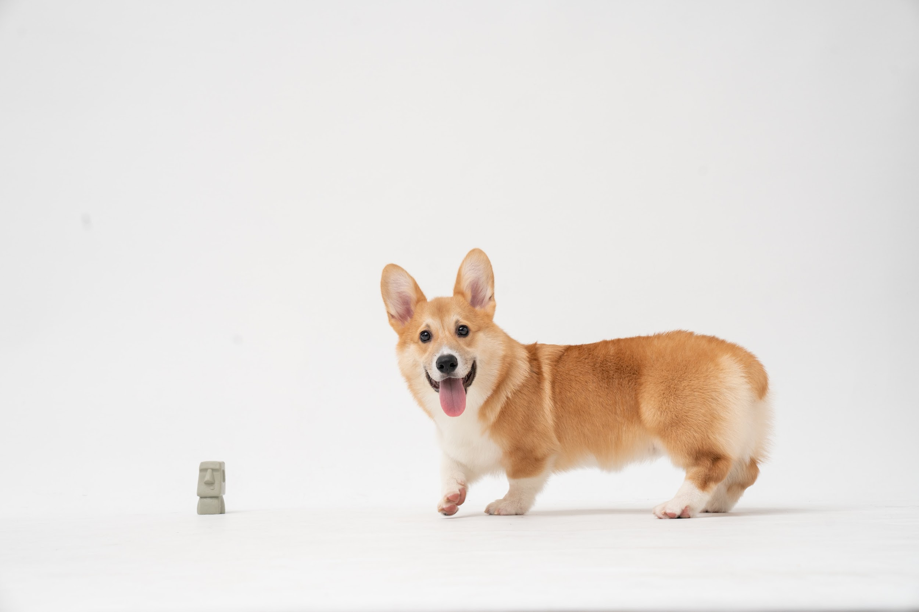
3
Methodology
How we’ve been doing it

Slide 11
Existing model - K-Nearest Neighbours (KNN)
How does this work?
78%
Classification of observation depends on the number of surrounding data points taken as reference
E.g. Classification of ‘Resource guarding’:
If K = 3 → Dog
If K = 5 → Cat
Accuracy
Kennel
Litter box
Resource guarding
Long walk
Meowing
Scratching post
Notes:
The current beta app uses K-nearest neighbours as the prediction model for classifiying customer inquiry and recommending relevant information to them.
We gathered feedback and were told that model is not accurate enough. Did a test and the current accuracy of the model is only 78%.
We worked on this final product that is now achieving 90% accuracy and we are presenting it as part of our final product release
Before i proceed, I’ll give a quick introduction of how the existing model works.

Slide 12
Potential model - Naive Bayes
P (dog-related post): 0.60
Classification of the text post is based on comparing the conditional probabilities of the it belonging to either r/CatAdvice or r/DogAdvice
P(Cat | ‘night walk’) vs P(Dog | ‘night walk’)
15
10
4
Toy
Walk
Night
“night walk”
10
2
9
Toy
Walk
Night
P (cat-related post): 0.40
Notes:
Bernoulli - to classify data into 2 classes
Multinomial - to classify data into multiple classes
Gaussian
P(dog)xP(night|dog)xP(walk|dog) → proportional to P(dog|’night walk’) → use this to compare with the same for the cat. Higher probability wins.
E.g. P(night|dog)=4/(15+10+4)
Assumption: Probability of words occurring are independent of each other.
To compare probability of the phrase belonging to r/CatAdvice or r/DogAdvice given that the text post contains ‘night walk’ Classified according to the highest probability

Slide 13
Potential model - Logistic Regression
Toy
Walk
Night
…
Cat (0)
Dog (1)
Each word/token within the model are weighted according to their importance to the respective categories
The model will generate the probabilities for each category
The text post will be labelled according to the category with the highest probability
Probability
Notes:
Outcomes are dichotomous for our use case - dog or cat
Logistic function will generate the probability of whether the text belongs to cat or dog category based on the weighted combination of the features (words/tokens).
The post will then be classified to the ‘cat’ if the probability of the contents being associated with ‘dog’ is lower than the threshold.

Slide 14
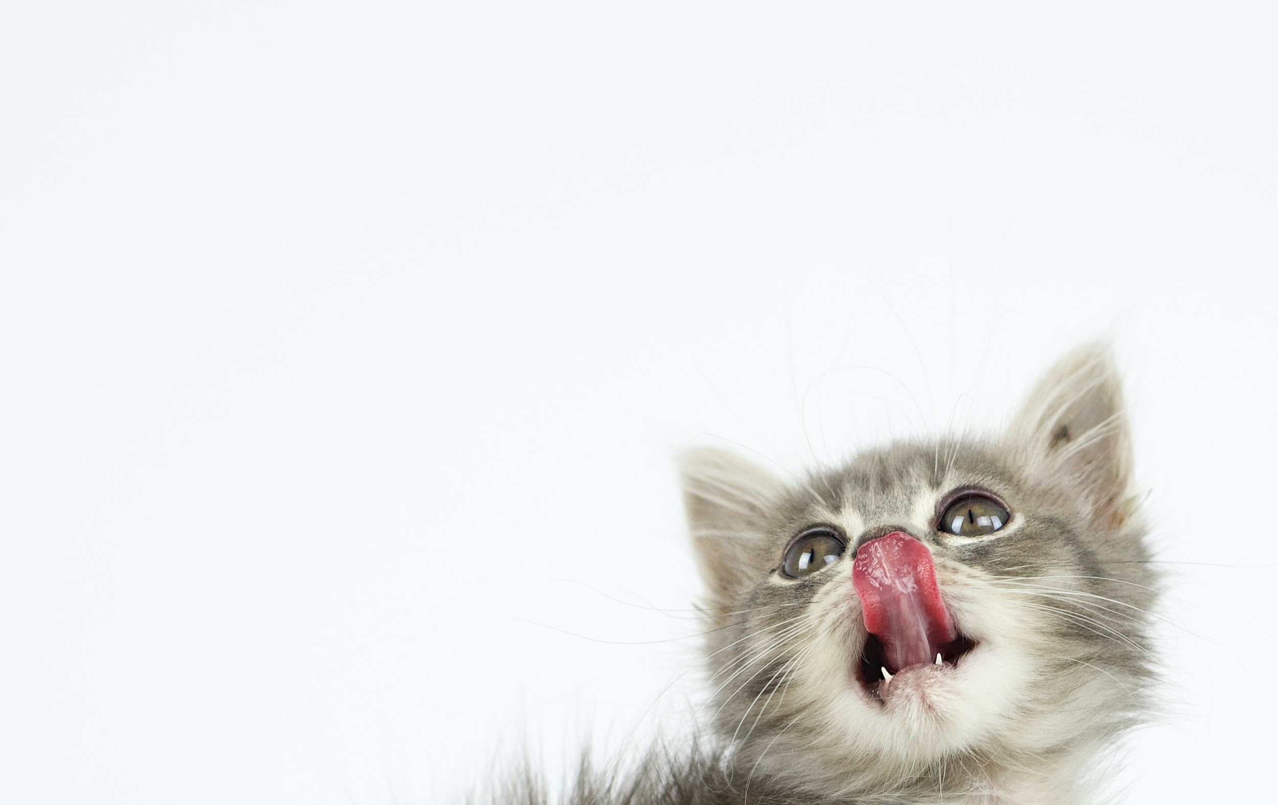
4
Data Collection & Cleaning
How we collect and clean the information

Slide 15

Overview of data collected
r/CatAdvice and r/DogAdvice
User-generated data scrapped using Pushshift API
 | r/CatAdvice | r/DogAdvice
Period of Posts | 12 Oct - 24 Nov | 25 Aug - 24 Nov
No. of Posts | 4,247 | 4,000
Size of Community | 119K | 66.5K
Notes:
Open source platform
Largest community for cat and dog respectively
cat adv earliest post was 12 Oct and last post was 24 Nov
dog adv earliest post was 25 Aug and last post was 24 Nov

Slide 16
Cleaning process
Content Management
Posts w/o main text were dropped
Text data for analysis: Main text + Title
Both categories have 2,300 data points for analysis
Word Processing
Removed stopwords, punctuation, digits, random characters, URLs
Transformed each word to lower-case and lemmatise*
Removed Common Terms
Words that are related to either categories e.g. “dog”, “cat”, “kitten”, “puppy”
Words that are common to both categories e.g. “vet”, “veterinarian”, “month”, “old”
*Lemmatisation is the grouping of inflected forms of similar words so that they can be analysed as a single term (often as the root word)

Slide 17
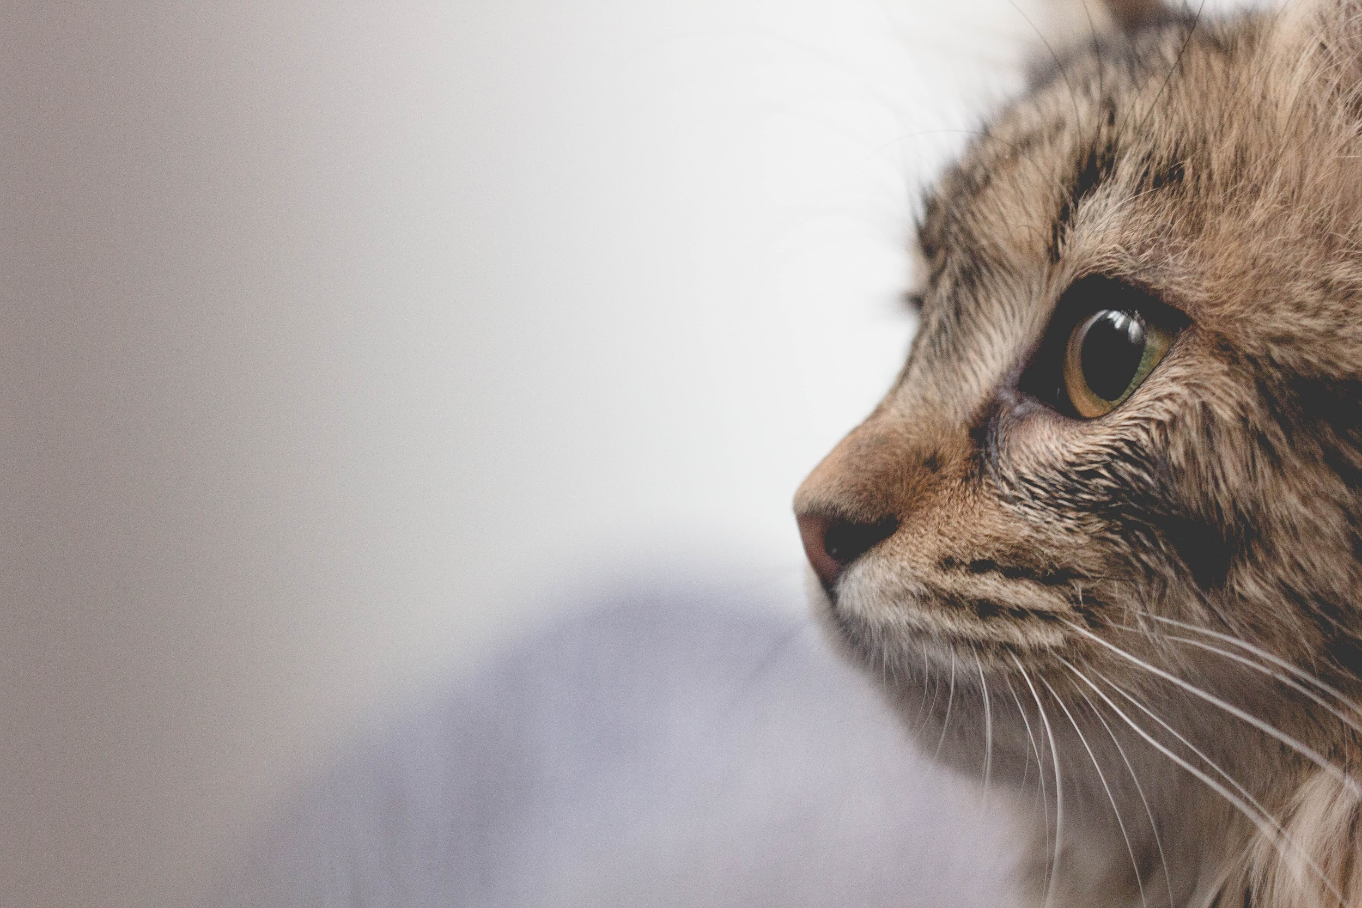
5
Exploratory Data Analysis
Zooming in on our data

Slide 18
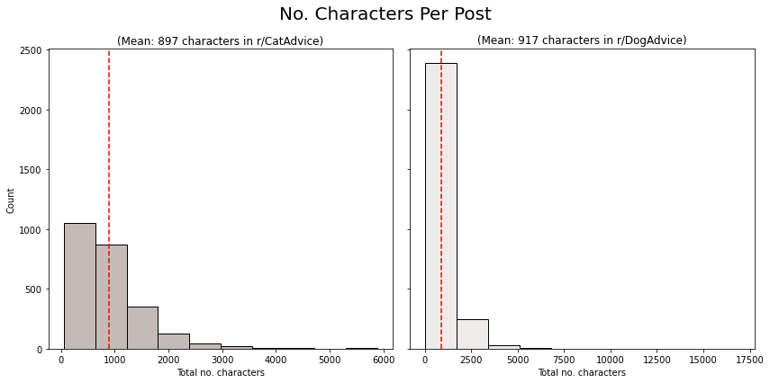
Higher average character count in r/DogAdvice
Maximum no. characters: 5,885 in r/CatAdvice & 16,898 in r/DogAdvice
Minimum no. characters: 56 in r/CatAdvice & 39 in r/DogAdvice

Slide 19
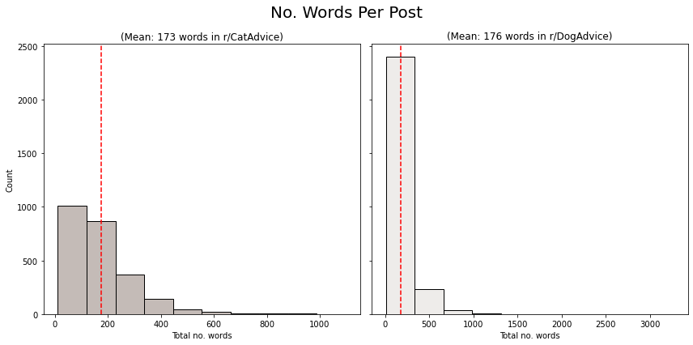
Similar word count average in both subreddits
Maximum no. words: 1,097 in r/CatAdvice & 3,267 in r/DogAdvice
Minimum no. words: 11 in r/CatAdvice & 9 in r/DogAdvice

Slide 20
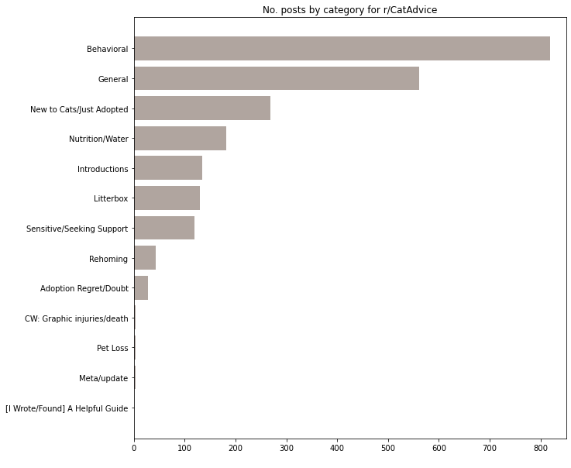
Behavioral queries tops r/CatAdvice discussion
Top topics tagged:
Behavioral: 818 posts
General: 561 posts
New Cats/Newly adopted: 269 posts

Slide 21
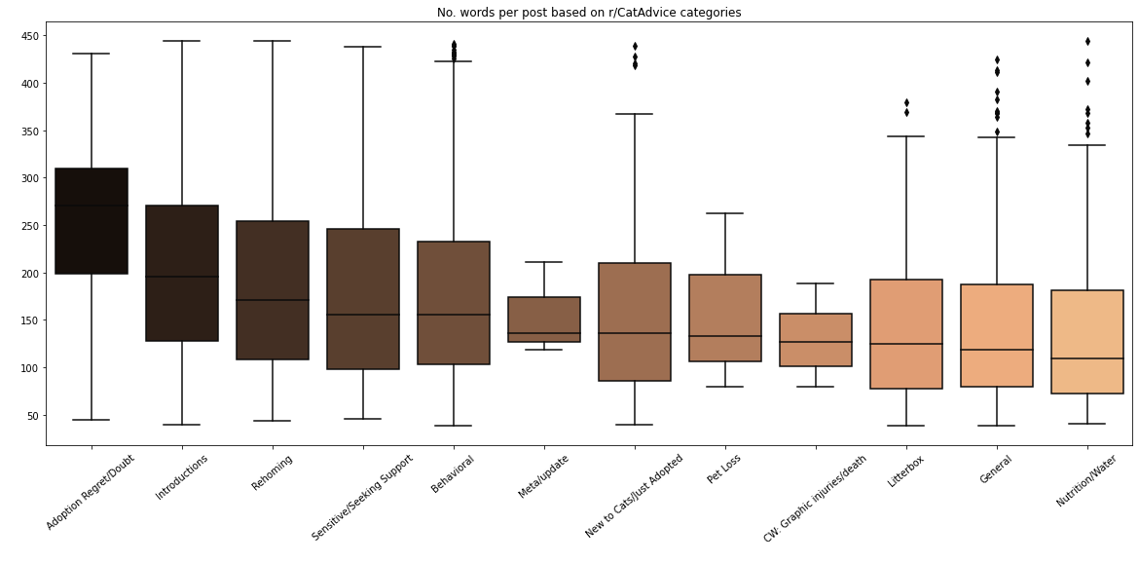
Highest word count average on Adoption Regret/Doubt
Adoption Regret/Doubt: 248 average no. words
Introductions: 206 average no. words
Behavioral: 175 average no. words

Slide 22
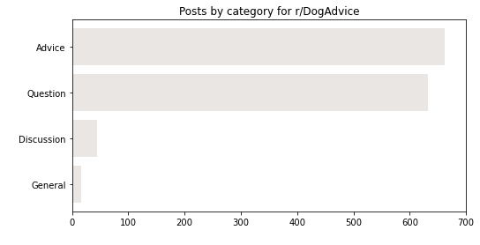
More general categories in r/DogAdvice
Top topics tagged:
Advice: 662 posts
Question: 632 posts

Slide 23
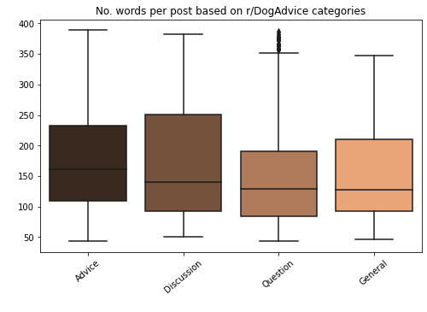
Highest word count average for Advice category
Advice: 177 average no. words
Discussion: 174 average no. words

Slide 24
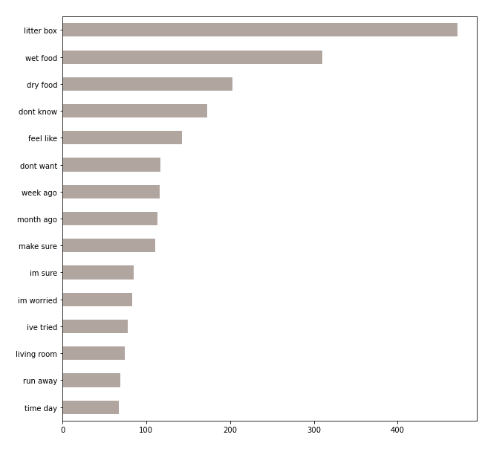
Top 2-word queries in r/CatAdvice
‘Litter box’
‘Wet food’
‘Dry food’
Users are concerned with their cats’ environment and nutrition.

Slide 25
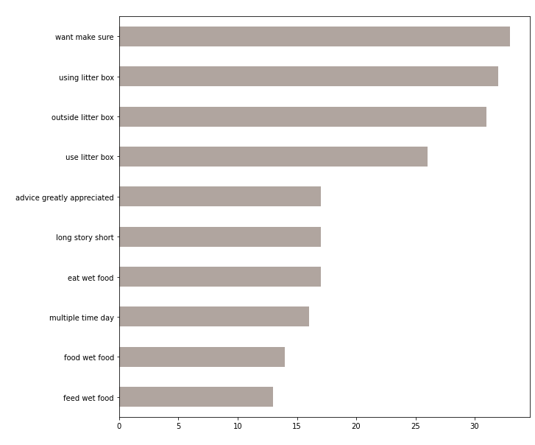
Top 3-word queries in r/CatAdvice
‘Using litter box’
‘Outside litter box’
‘Use litter box’
This reaffirms that users are most concerned with their cats’ environment.

Slide 26
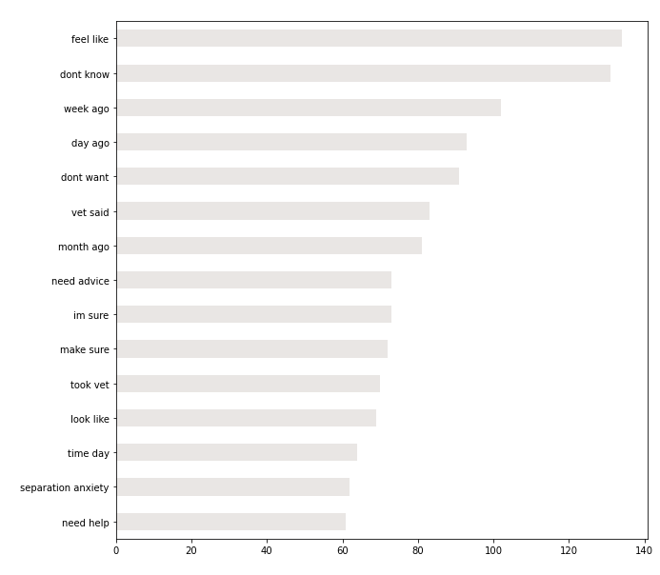
Top 2-word queries in r/DogAdvice
‘Feel like’
‘Don’t know’
‘Need advice / help’
‘Separation anxiety’
Users seem mostly uncertain about the issues faced. The only issue mentioned is ‘separation anxiety’.

Slide 27
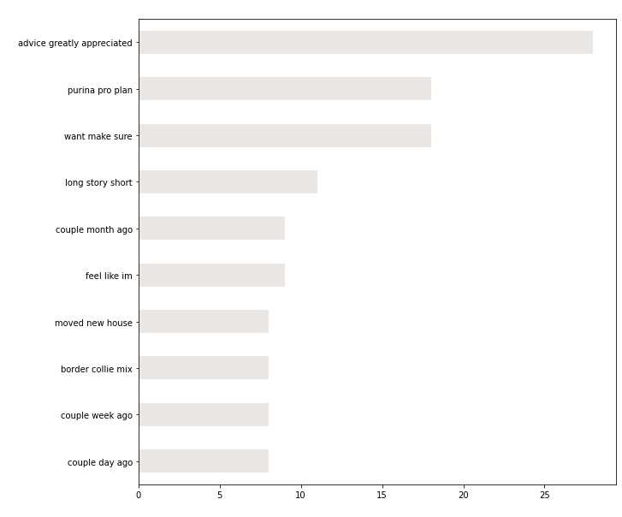
Top 3-word queries in r/DogAdvice
‘Advice greatly appreciated’
‘Purina pro plan’
‘Want make sure’
This reaffirms users in this forum could be more uncertain and may require more support.
‘Purina pro plan’ was mentioned often - this is a formula to improve dog’s digestion.

Slide 28
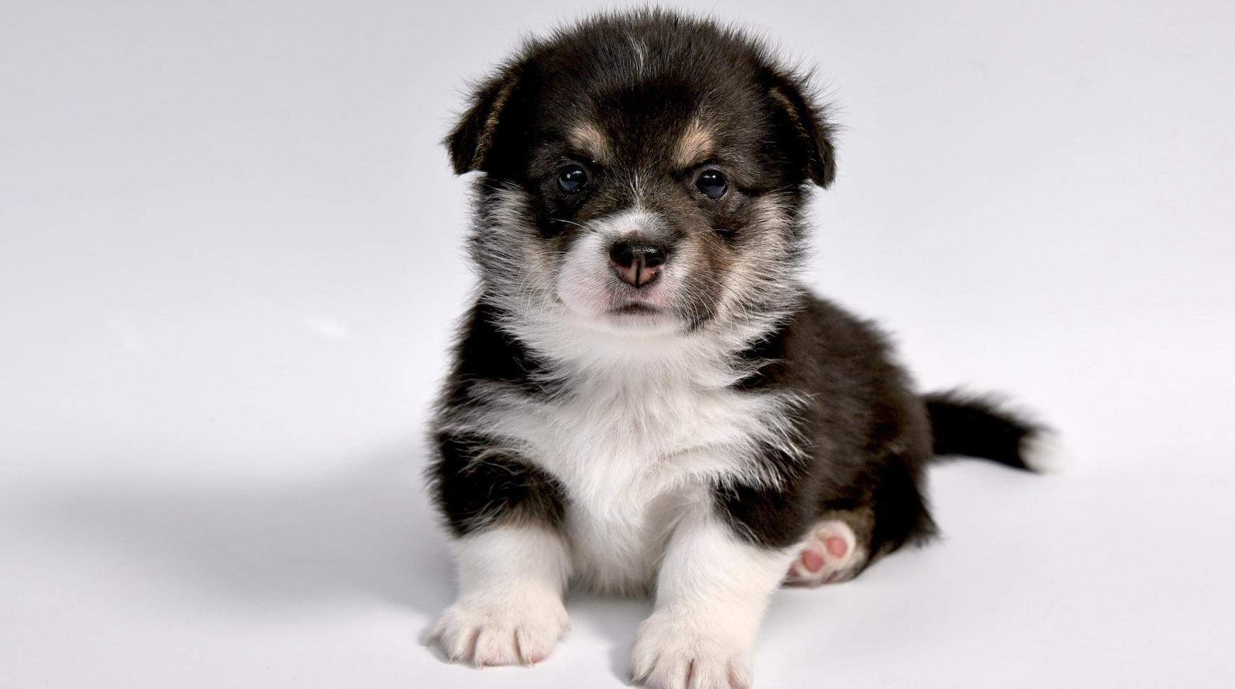
6
Classification Models
Processing our data

Slide 29




Data preparation and modelling
Split to 2 datasets
for model training and testing
Data transformation to convert words to numbers
Train and evaluate models
Notes:
Thank you Joanne. After we have done the extensive data cleaning and exploration, we split the data into 2 datasets. One is for model training and the other one is for testing. With two separate datasets, it will allow us to train and evaluate our model on whether it can still perform well or as expected on unseen test dataset. We also perform transformation on our datasets as the models require the data to be in form of numbers. We used techniques such as CountVectorizer and Tf-idf Vectorizer to convert texts to numbers by counting the frequency at which the words or 2-word phrases appear in the respective posts of the subreddit. Several classification models and evaluation metrics were used to find the best model for implementation. More details will be shared in the next slide.

Slide 30
The training models and measure of success
Classification Models:
Logistic Regression
Naive Bayes (Multinomial, Bernoulli and Gaussian)
Evaluation Metrics:
Accuracy Score
No. of observations classified correctly / Total positive and negative observations
F1 score
Balance of precision and recall on positive observations
What we’re looking for:
Higher Accuracy Score
Higher F1 score
Better Model Performance
Notes:
We have looked at various classification models and have decided on Logistic Regression and Naive Bayes. The 3 types of Naive Bayes are Multinomial, Bernoulli and Gaussian. They are chosen because the algorithms work quickly since response time is especially important for our chatbot. These models also provide a measure of how appropriate a factor is contributing to the classification, which will allow us to conduct further analysis. As for the evaluation metrics, we have decided to use the accuracy score and the F1 score. Accuracy score measures the percentage of the observation classified correctly. The higher the accuracy score, the better the model performance. As for the F1 score, it measures the accuracy of the model and how good the model is able to classify the posts to the 2 categories. It is a balance of precision and recall on positive observations. Likewise to the accuracy score, the higher the F1 score, the better the model performance.

Slide 31
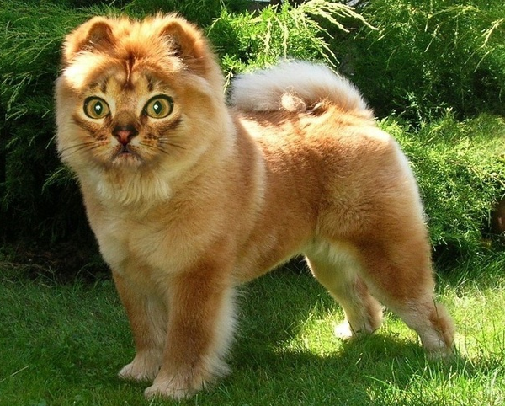
Cat or dog?
Notes:
Basically, We want to build an effective model to be able to differentiate the posts between cats and dogs.

Slide 32
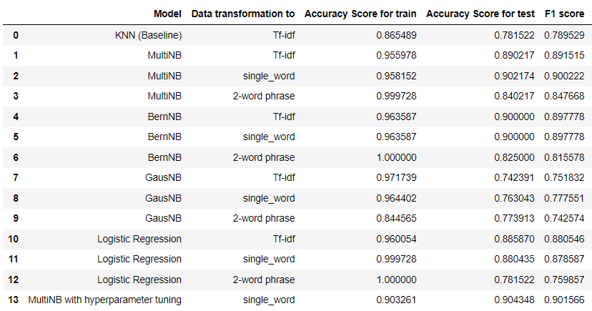
Multi Naive Bayes achieved 90% accuracy & F1 score
Selected model for tuning
Best result post-tuning
Notes:
After the confirmation of models and evaluation metrics, we ran models on the various word and phrase types. Multinomial Naive Bayes model on single word gave the best performance with accuracy score for train and test datasets as well as F1 score above 90%. This model has also shown a lesser degree of overfitting on the train dataset because it has smaller gap between the train and test accuracy score. We also conducted further optimisation to the model by tuning the hyperparameters. It has closed the gap between the train and test’s accuracy score as well as resulted in a slight increase in the test and F1 score. Our model has achieved a high accuracy score of 90%, which is 12% higher than the current model using K_nearest neighbors.

Slide 33
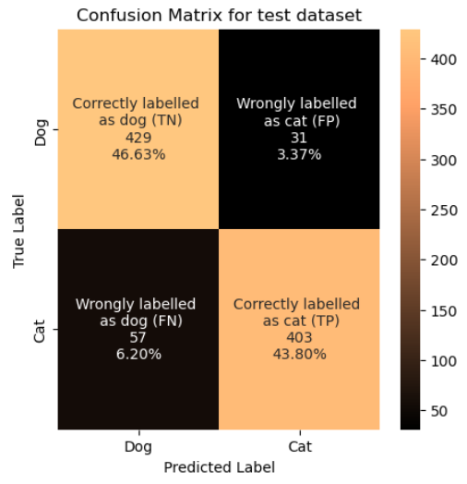
90% of predictions are correctly labeled
Highly accurate model
Total Observations: 920
Correct classifications: 832
Low Misclassification
Wrongly labeled as dog: 6.2%
Wrongly labeled as cat: 3.3%
Notes:
Below is a more detailed breakdown of our model performance on the test dataset. Out of the 920 posts, 90% of the posts were correctly classified as cat or dog. 3.3% of the posts were wrongly classified as cat while 6.2% of the posts were wrongly classified as dog. This number is relatively small.

Slide 34
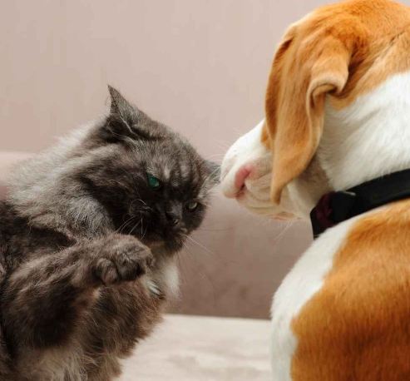
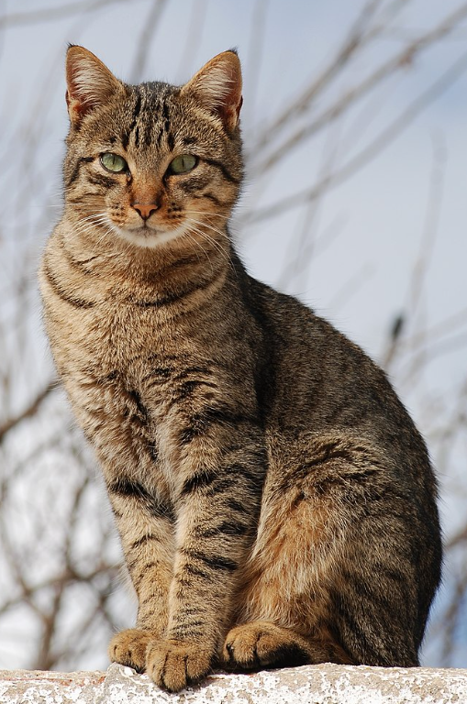
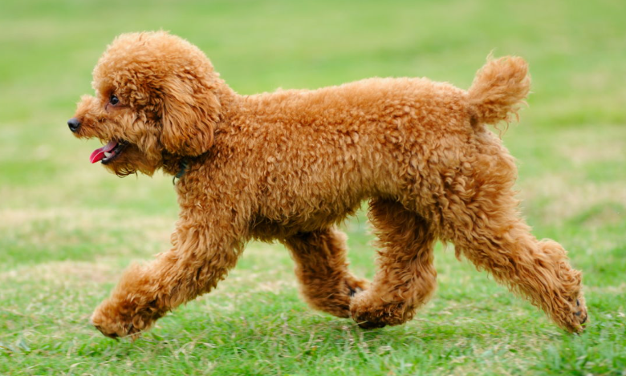
Distinct words between cats and dogs
Top 10 words for cats
Meowing
Meow
Swat
Litterbox
Galaxy
Jackson
Feliway
Diffuser
Tabby
Resident
Woof!
Top 10 words for dogs
Bark
Trainer
Flea
Diarrhea
Infection
Treatment
Collie
Poodle
Terrier
Daycare
Meow!
Behaviours
Swat
Behaviours
Medical
Tabby
Dog types
Cat types
Poodle
Notes:
Next, we did further analysis on the top 10 words in the posts that have high impact on the model’s classification. The top 10 words for cats are mainly related to cat behaviours such as meowing and swat. Some of you may familiar that cat swat sometimes. It could be due to redirect aggression, playfulness or them trying to get your attention. Cats use litterbox whereas dog may use potty or they do their business outdoor. You may be wondering what galaxy and jackson has to do with cat’s behavior. From our research, Jackson Galaxy is a famous Youtuber and an American cat behaviourist who is a specialist in managing the behavior of cats. Feliway diffuser is a product that helps reduce signs of stress in cats. Tabby is a type of cat with a ‘M’-shaped marking on its forehead. As for the top 10 words for dogs, they are mainly related to behaviors and medical conditions. There are also unique words for dog types. From these top words, It is unexpected that resident and daycare are strong predictors of cat and dog respectively. These appear to be common words that can be used for both cats and dogs. Perhaps, it is because some dog owners are worried to leave their dogs home alone all day, while cat owners feel safe to leave their cats at home as their cats will cope on their own. In summary, these top words are relatively distinct to dogs and cats and hence, it has contributed to the high model accuracy. I will now hand over the presentation to Florian who will share on the conclusion and recommendation.

Slide 35
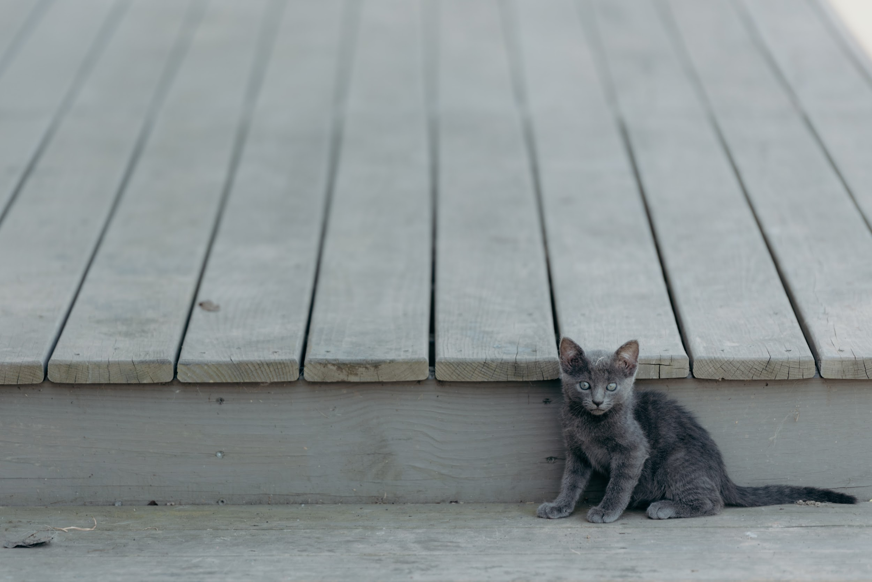
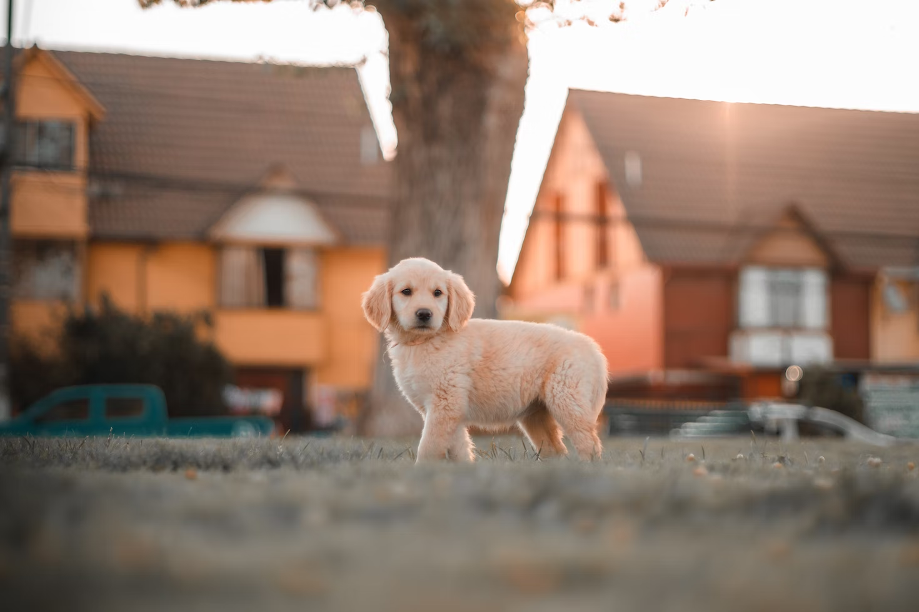
7
Conclusion and Recommendations
Our key takeaways

Slide 36
Model Results Recap
8000
90%
12%
Number of posts
Accuracy
Increase in accuracy
Extensive content that allow our model to be trained accurately
Less than 10% of content is misclassified
New model is outperforming previous model by 12%

Slide 37
Conclusion
Problem statement:
With an influx of inexperienced pets owners overly reliant on vets and pet store, how can we better optimize everyone’s time?
Refocus your business
Reduce dependance
Focus on the core of your business
Treating pets
Driving sales growth
Provide users with extensive and comprehensive articles to cover all their basic needs
Leverage insight
Increase care
Get information on customers/patients
Based on their app usage
Reduce abandonment rate
Ensure timely treatment for pets

Slide 38
Limitations
Article availability
Cat/Dog specific
Context
Limited availability of articles at launch
Rapidly expand based on popular topics and what are people looking for
Cat and dogs are the most popular pets
Model currently limited to cat and dog classification
Recommendations and articles are based on global trends
Not specific to Singapore

Slide 39
Recommendations
Manpower
Communication
Adjust manpower needed to answer phone calls and emails and shift your attention to what really matters
Improve on communications and website by focusing on popular and trending terms
Digitalisation
Inventory / Stocks
Display QR codes or provide a device your customers can use to browse articles or get answers
Keep up to date with current trends or outbreaks to always have stocks for critical and popular products

Slide 40
Roadmap
Q1 2023
Q2 2023
Q4 2023
2025
Offer weekly surveys to gather insights on users preferences and needs
Provides insights from user usages.
Popular question
Survey results
Organize events and workshops with end users and partners
Deploy service to other countries
Cater to local markets

Slide 41
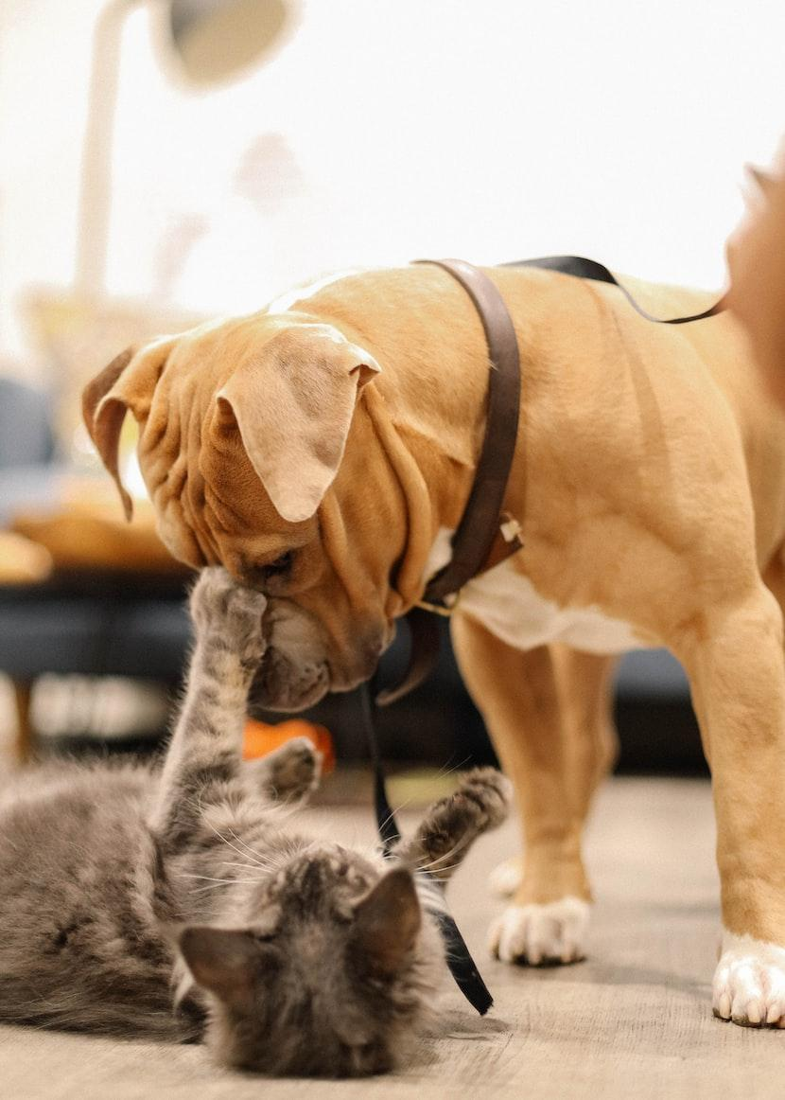
Thank you!
Questions?
Reach us at petwhisperers@smartpet.com

